Slide 1
16.32 Project: Optimal Control for Autonomous Drone Racing
by Aleix Paris i Bordas

Slide 2
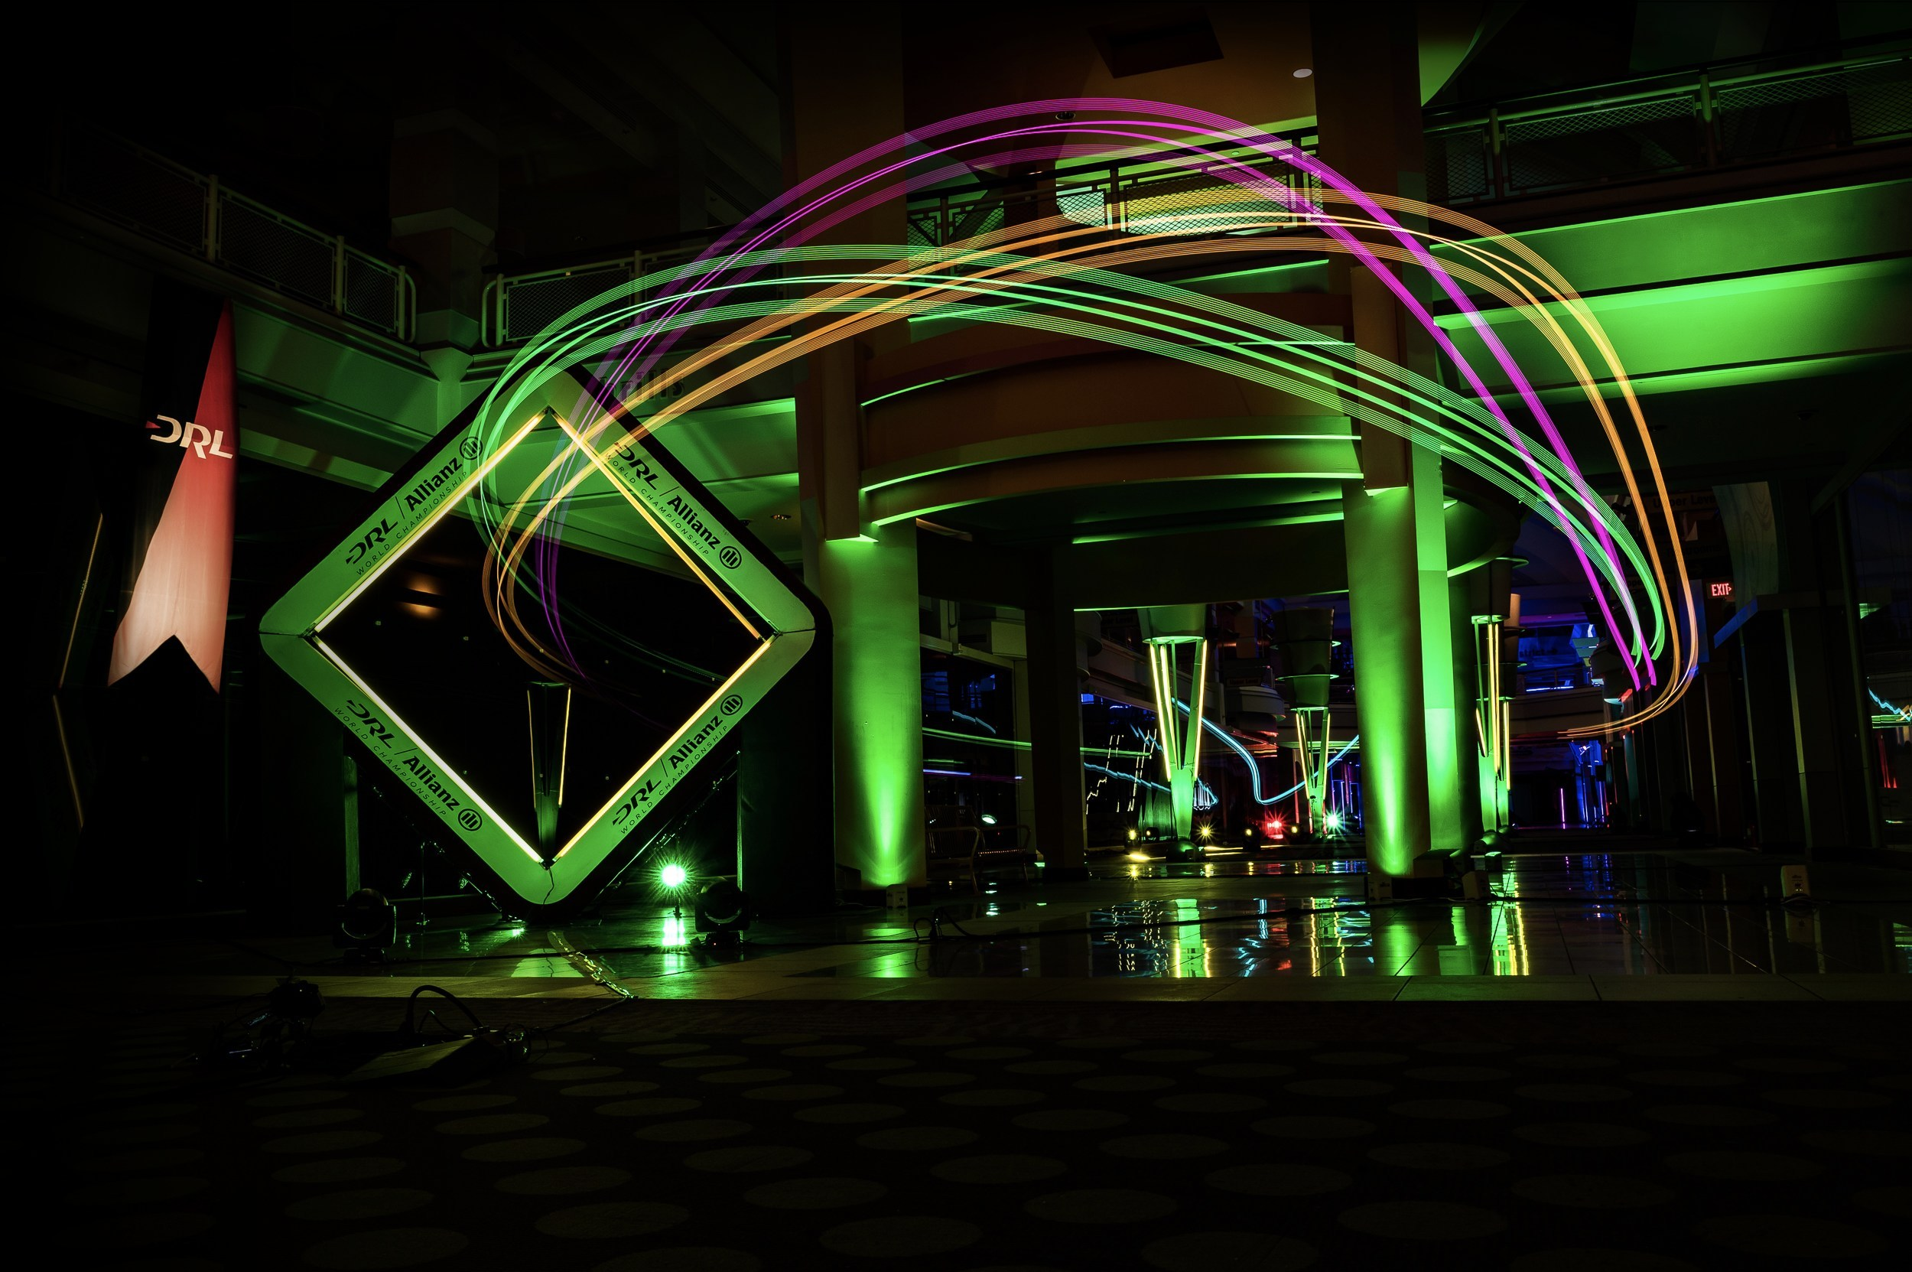
Introduction
Optimal control in aerospace: Red Bull Air Race
In recent years: drone racing
In the following years: autonomous drone racing

Slide 3
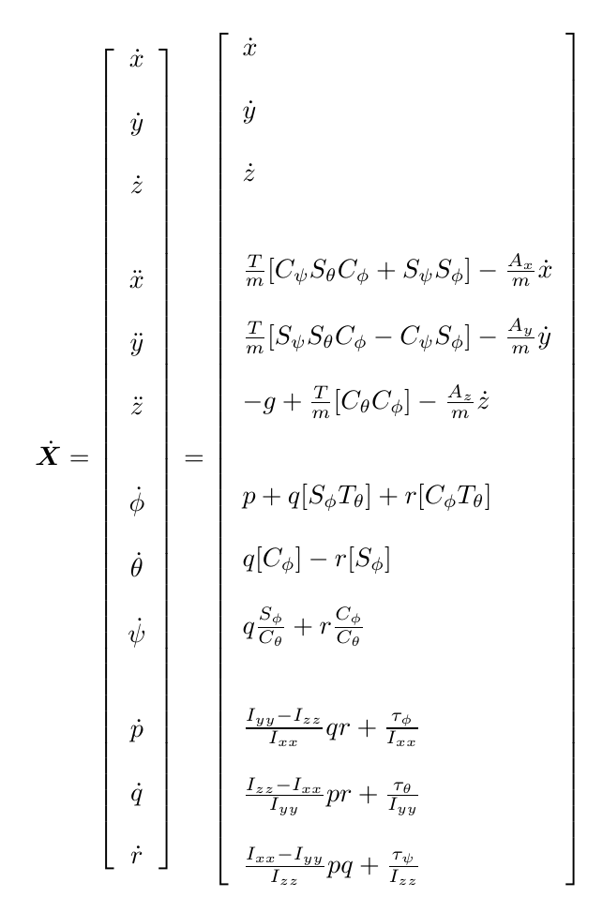
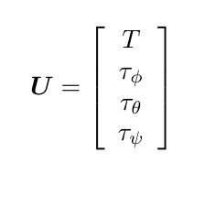
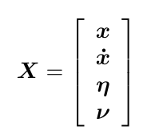
Quadrotor Dynamics and State-space Model
12 states, 4 control inputs:

Slide 4
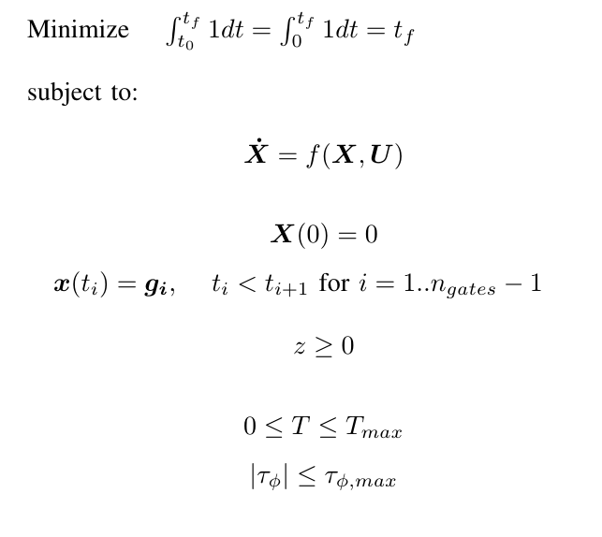
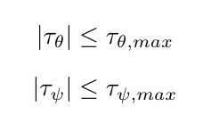
Mathematical Formulation

Slide 5
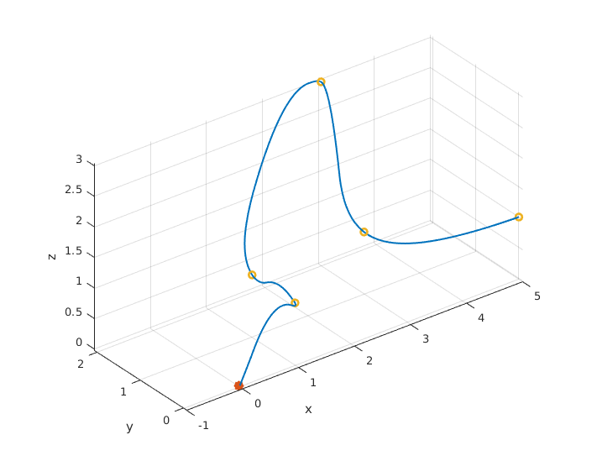
Results

Slide 6
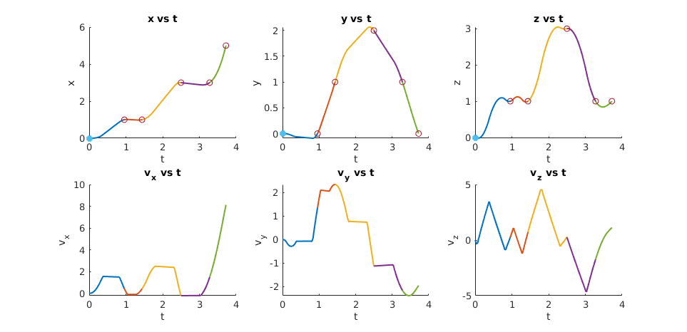
Results

Slide 7
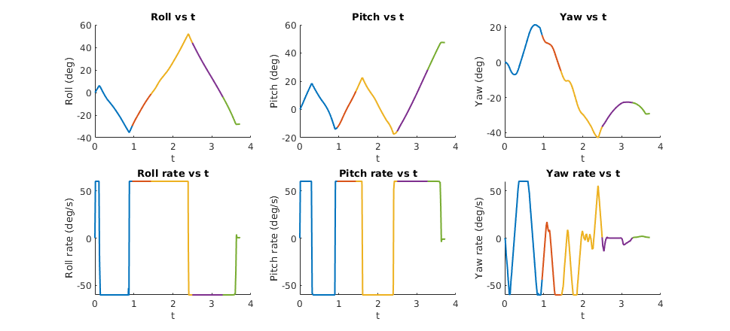
Results

Slide 8
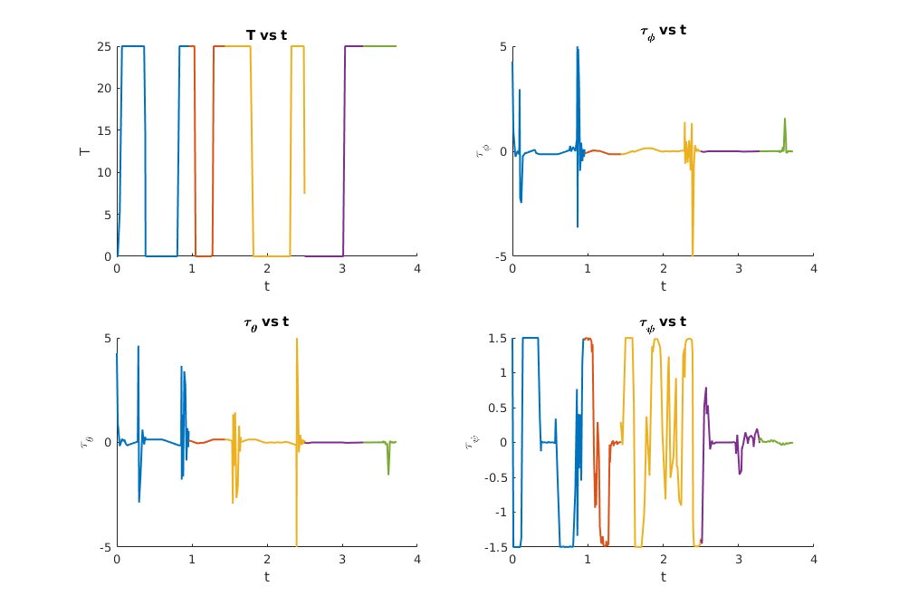
Results

Slide 9
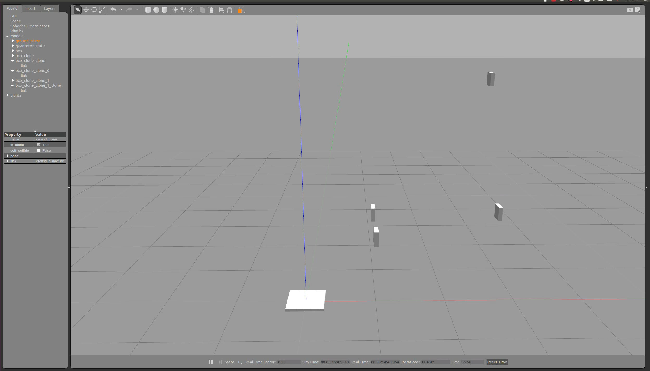
Results

Slide 10
16.32 Project: Optimal Control for Autonomous Drone Racing
by Aleix Paris i Bordas

